Slide 1
DETECTING PARKINSON’S DISEASE WITH XGBOOST

Slide 2
OBJECTIVE
To analyze and visualize the data to find which kind of people are prone to Parkinson’s Disease.
To build a model to accurately detect the presence of Parkinson’s disease in an individual.

Slide 3
What is Parkinson’s Disease
Parkinson’s disease is a progressive disorder of the central nervous system affecting movement and inducing tremors and stiffness.
It has 5 stages to it and affects more than 1 million individuals every year in India.
This is chronic and has no cure yet.

Slide 4
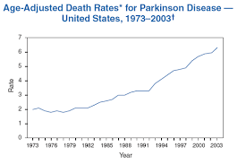
NEED FOR THIS MODEL
1.Death rates are increasing year by year.
2.Disease has to be Diagnosed as earlier as possible.

Slide 5
WHAT IS XGBOOST ?
XGBoost is a new Machine Learning algorithm designed with speed and performance in mind.
XGBoost stands for eXtreme Gradient Boosting and is based on decision trees.

Slide 6
DATASET INFORMATION
This dataset is composed of a range of biomedical voice measurements from 31 people, 23 with Parkinson's disease (PD).
Each column in the table is a particular voice measure, and each row corresponds one of 195 voice recording from these individuals ("name" column).

Slide 7
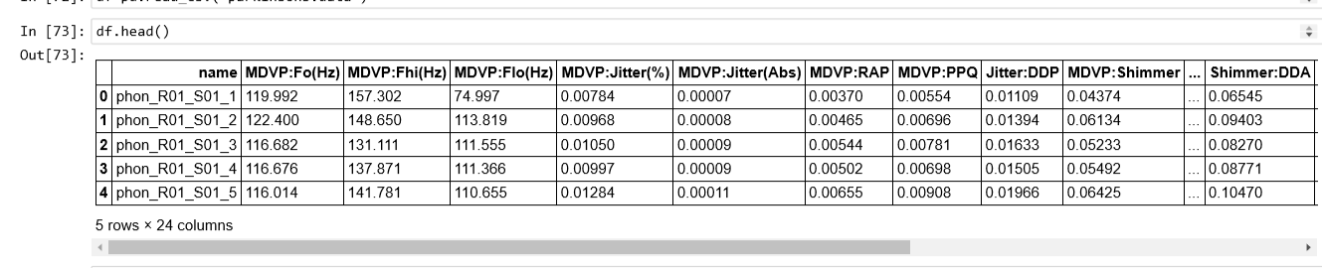

Slide 8
ATTRIBUTE INFORMATION:
name - ASCII subject name and recording number
MDVP:Fo(Hz) - Average vocal fundamental frequency
MDVP:Fhi(Hz) - Maximum vocal fundamental frequency
MDVP:Flo(Hz) - Minimum vocal fundamental frequency *
MDVP:Shimmer,MDVP:Shimmer(dB),Shimmer:APQ3,Shimmer:APQ5,MDVP:APQ,Shimmer:DDA - Several measures of variation in amplitude
NHR,HNR - Two measures of ratio of noise to tonal components in the voice
status - Health status of the subject (one) - Parkinson's, (zero) - healthy
RPDE,D2 - Two nonlinear dynamical complexity measures
DFA - Signal fractal scaling exponent * spread1,spread2,PPE - Three nonlinear measures of fundamental frequency variation.

Slide 9
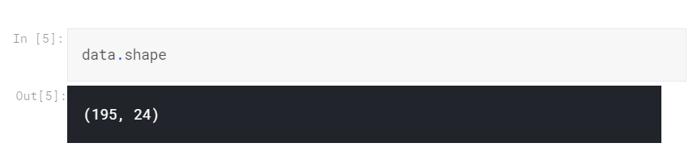
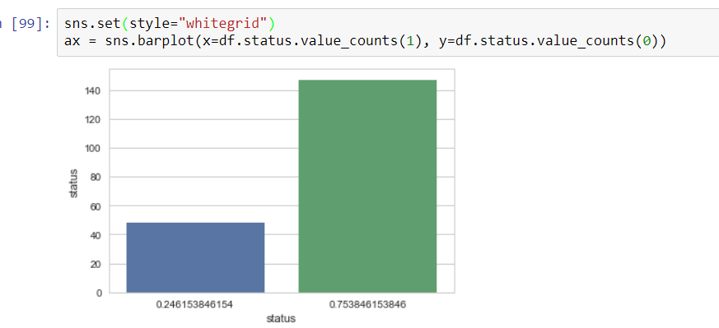
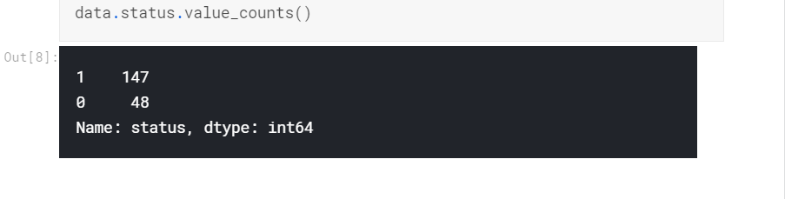
SIZE AND LENGTH
Data set Size: 39.7 KB
Number Of Rows=195
Number Of columns=24
Number of people affected by PD

Slide 10
Module description
In this Python machine learning project, using the Python libraries scikit-learn, numpy, pandas, and xgboost, we will build a model using an XGBClassifier.
We’ll load the data, get the features and labels, scale the features, then split the dataset, build an XGBClassifier, and then calculate the accuracy of our model.

Slide 11
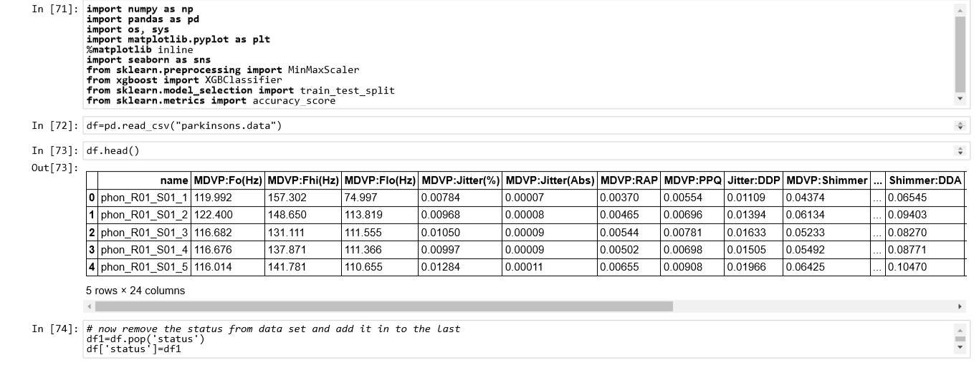
How To Start ?

Slide 12
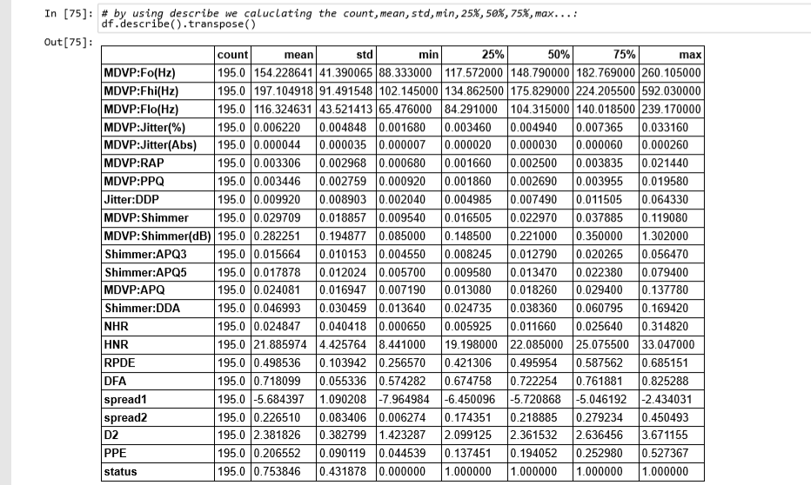

Slide 13
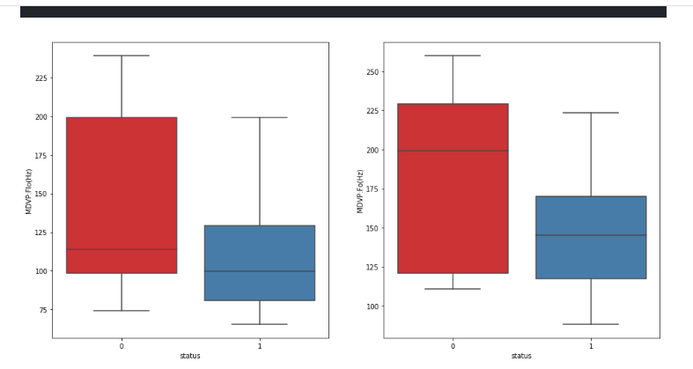

Slide 14
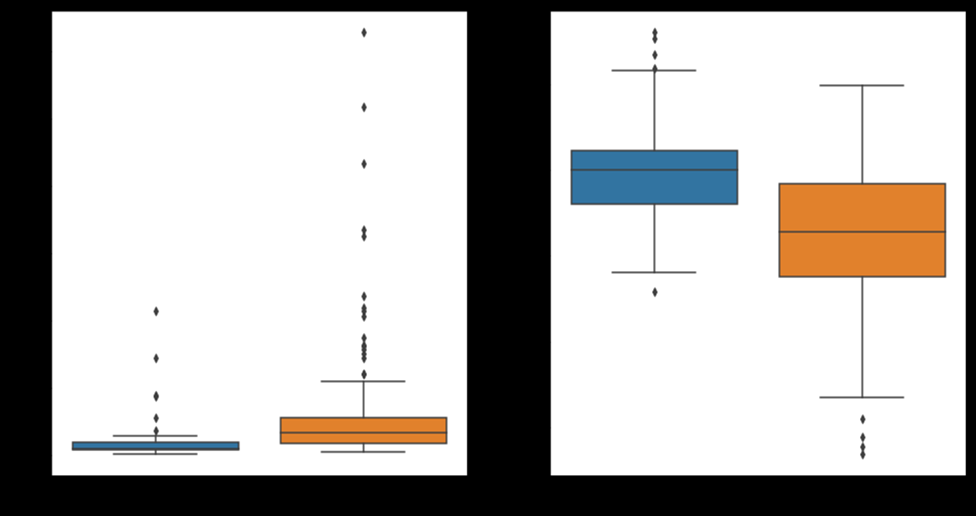
NHR
HNR
Status
Status

Slide 15
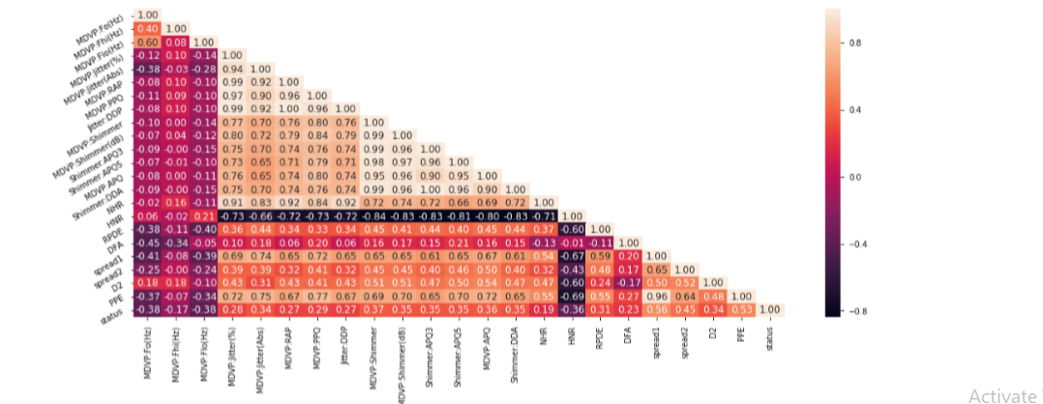
The target variable status has a weak positive correlation with spread1

Slide 16
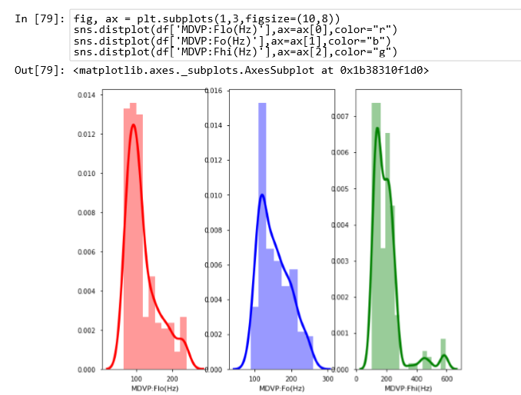
occurrence

Slide 17
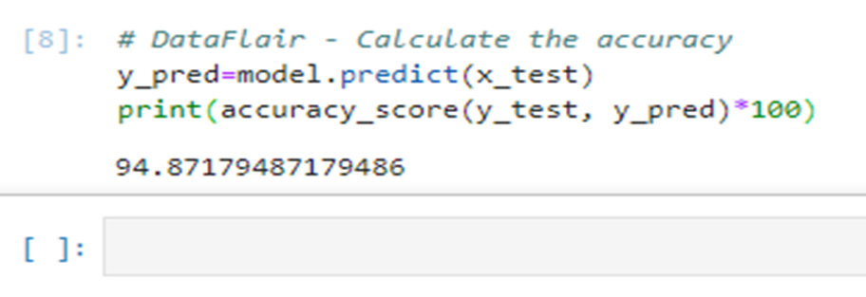
RESULTS
In this Python machine learning project, we learned to detect the presence of Parkinson’s Disease in individuals using various factors.
This gives us an accuracy of 94.87%, which is great considering the number of lines of code .

Slide 18
THANK YOU

